Slide 1
Excel I – tables & VLOOKUP
Management Information Systems
Disha Parkhi

Slide 2
Outline
Tables: total row, sorting, applying filters and structured references
The IF and VLOOKUP functions
Appendix I: nested MATCH and INDEX
Appendix II: data validation
Appendix III: error codes list and useful text and date functions

Slide 3
Ms Excel
Main purpose is to organize, calculate and evaluate quantitative data.
Some features:
Easy to enter and format data
Ability to create graphical or visual representations of your data
Can work quickly in analyzing large amounts of data
Can be used for what if analysis and decision making based on several features (one of those features we are going to study are PivotTables)

Slide 4
Planning for effective worksheet design
It is a good idea to plan the structure of the spreadsheet before starting entering the data.
State the purpose of the worksheet.
Decide what input values are needed: create a range of cells to enter values for your data and use clear labels. This is the input area.
Decide what outputs are needed to achieve the purpose of the worksheet: create an output area, a range of cells that contains the results of manipulating values in the input area.
A good practice is to avoid constants (raw numbers) in formulas and instead use references to cells containing those numbers.

Slide 5
Entering the data
After planning and building the structure of the worksheet, it is time to enter the data.
Enter the labels, values and formulas: change the input values to test that your formulas produce correct results.
Format the numerical values in the worksheet: adjust the number of decimal places as needed, use the Accounting Number Format and Percent Style.
Format the descriptive titles and labels attractively but so as not to distract your audience from the purpose of the worksheet. Include a descriptive title.

Slide 6
Excel vs Access
Excel is for data analysis
Access is for data management
Targets numerical data
Charts
Summaries with pivot tables
Short learning curve
Maintaining a massive Excel spreadsheet with thousands of entries becomes increasingly difficult and as your data evolves the need to update your formulas, summary ranges
Database structure
Data organization and storage
Data consistency and redundancy control
Complex queries
Can deal with a large amount of data

Slide 7
Excel tables
Staff.xlsx and Staff_solutions.xlsx

Slide 8
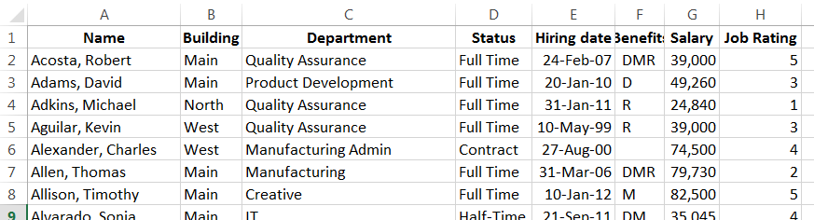
The Staff data
Technically, this is a range, not a table yet

Slide 9
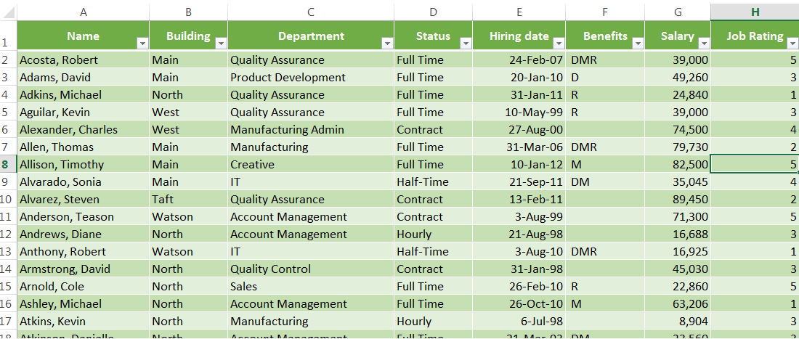
Format as an Excel table
Usually the small buttons on the cells of the first row mean that you have a table (there is an option to hide the buttons too).
Columns correspond to fields (similar to databases)
Rows correspond to different records

Slide 10
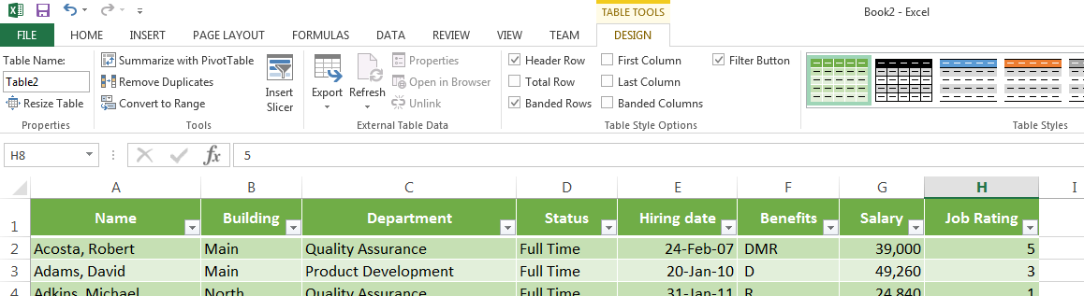
Table tools
A duplicate row in a table is a row that has exactly the same information in one or more columns.
Convert back to normal range in Excel
Creates a total row
Changes the appearance
Autofilter buttons (they are not printed)

Slide 11
What is the difference between a normal range and a table?
When you create a table in Excel you are activating features that facilitate dealing with a lot of data and that do not exist for a regular range:
Column headings remain onscreen when you scroll down;
Efficient sorting and filtering
Ability to create and edit calculated columns where the formulas copy down to rows automatically due to the use of structured references instead of cell references
Calculated total row with several possible functions

Slide 12
Total row
Create a total row that:
  counts the number of employees
  displays the average gross salary

Slide 13
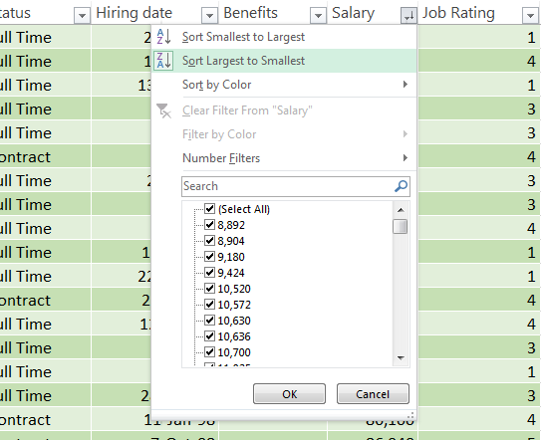
Sorting a table
When we want to sort with respect to only one field we can easily use the Autofilter button of the corresponding field.
Sort by salary (descending):

Slide 14
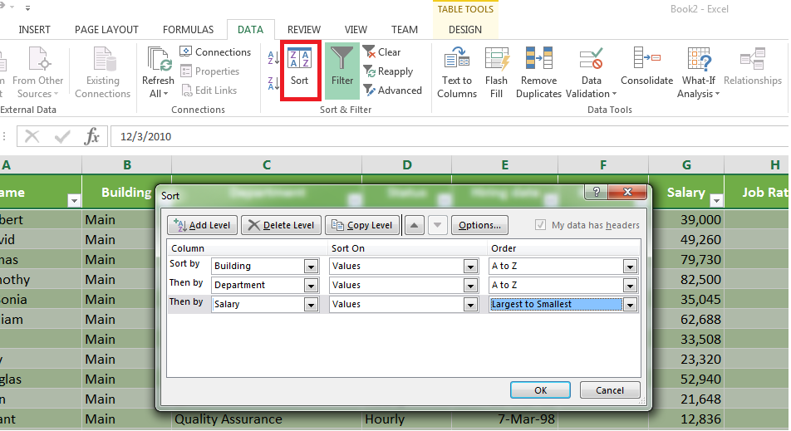
Sorting a table
When we want to sort with respect to more than one field:
Sort by Building, then by Department and then by Salary (descending):

Slide 15
Filters
When we have large tables it is not practical to display thousands of rows of data on screen at once. It is easier to work if you see just the data you currently need.
Filters specify which data is shown and which data is hidden based on the specified criteria.
To filter we use the Autofilter buttons.

Slide 16
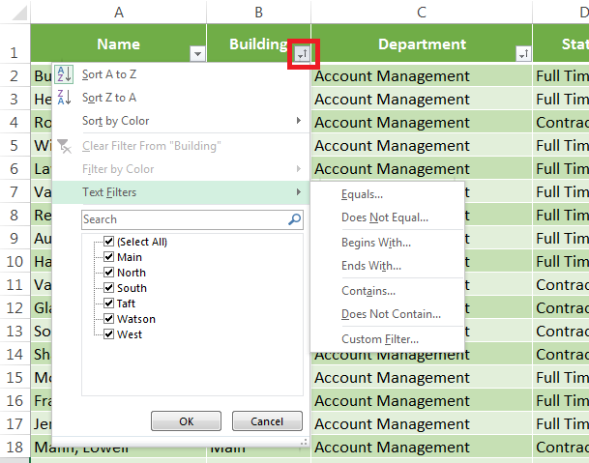
Text filters – options

Slide 17
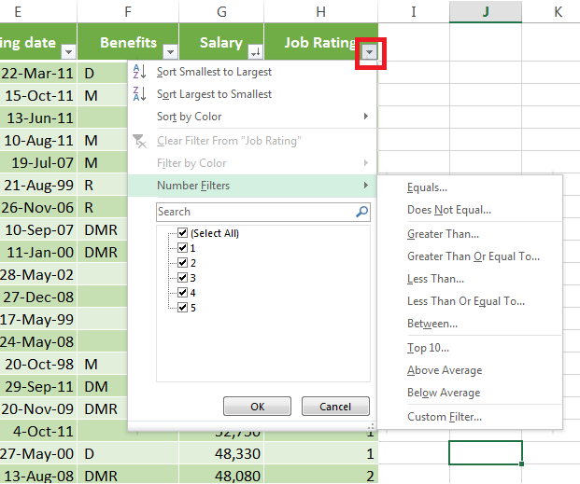
Number filters – options

Slide 18
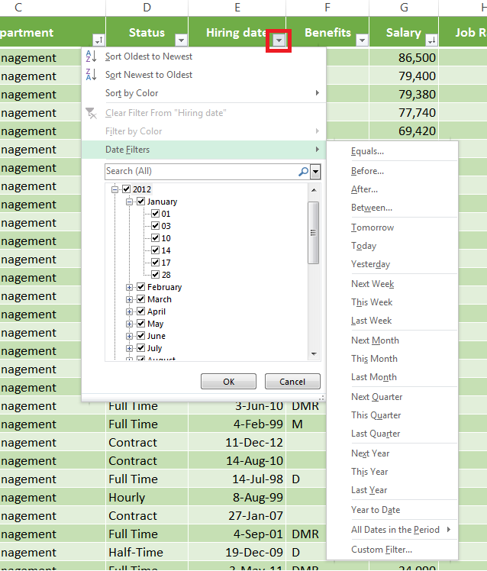
Date filters – options

Slide 19
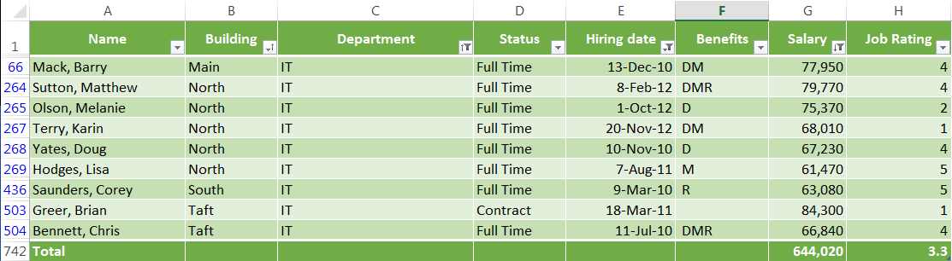
Multiple filters
Show the employees hired between 2010 and 2012, from the IT department and whose salary is larger than $50,000.
If I select this filtered table and copy it, it only copies the filtered rows.
The total row was updated to this view

Slide 20
Exercises – using filters
How many people are there in the Sales department that work by the hour?
How much does the company spend in salaries of the Marketing department? And what is the average salary of a Marketing person?
How many people do not have Medical (M) benefits that do not work by the hour?
What is the highest salary of a sales person?
How many marketing people are on contract?
How many people do not have any benefit?

Slide 21
Structured references
When working with tables in Excel, you can use structured references to make your formulas easier to understand. When you create an Excel table, Excel assigns a name to the table, and to each column header. When you add formulas to an Excel table, those names can appear automatically as you enter the formula and select the cell references in the table instead of manually entering them.
Formula using explicit cell references:
=IF(OR(H2=4,H2=5), 0.05*G2,0)
Formula using structured references:
=IF(OR([@Rating]=4,[@Rating]=5), 0.05*[@Salary],0)
To include structured references in your formula, click the table cells you want to reference instead of typing their cell reference in the formula.

Slide 22
Structured references
The names in structured references adjust whenever you add or remove data from the table, add or remove columns, or edit the column names.
What happens when I use explicit cell references in a table instead of structured cell references?
If you enter explicit cell references in a table, you cannot guarantee that the formula will be updated when you add columns, rows, or even when you sort or filter the table.

Slide 23
IF and VLOOKUP functions
Staff.xlsx and Staff_solutions.xlsx

Slide 24
Structured references
The company rewards the employees who have a job rating of 4 or 5 with a bonus of 5% of their salaries. Calculate the bonus and the final annual salary of each employee.
We are going to use the IF using structured references. The next slides explain the IF in general using explicit cell references, which is similar.

Slide 25
IF function
“The 5% bonus is given to employees who have a job rating of either 4 or 5 instead.”
=IF (I3>=4, H3*0.05, 0)
The IF function evaluates a specified condition (does I3>=4?) and returns one value if the condition is true (H3*0.05) and another if the condition is false (0).
In general:
=IF(logical_test, value_if_true, value_if_false)
To evaluate the condition we use comparison operators:
= | Equal to | <> | Not equal to
<= | Less or equal than | >= | Greater or equal than
< | Less than | > | Less than

Slide 26
AND nested in IF
We can also use AND nested in the IF function…
The logical test can be: if “the job rating is greater or equal than 4 and smaller or equal than 5”:
= IF( AND (I3>= 4, I3<= 5), H3*0.05, 0)
The AND function accepts two or more logical tests and returns TRUE if all conditions are true, and FALSE if at least one is false:
AND (logical_test1, logical_test2, logical_test3, …)

Slide 27
OR and NOT nested in IF
The logical test can also be: if “the job rating is either 4 or 5”:
=IF (OR (I3 = 4, I3 = 5), H3*0.05, 0)
The OR function accepts two or more logical tests and returns TRUE if at least one of the conditions is true, and FALSE if all are false.
OR (logical_test1, logical_test2, logical_test3, …)
The NOT function reverses the truth value of its argument (it returns true if the condition is false, and vice-versa).
NOT (logical_test)
AND, OR, and NOT, may also be used alone when you want a true or false answer, and need not necessarily be nested in the IF function.

Slide 28
(V/H)LOOKUP functions
(V/H)LOOKUP functions retrieve a value from a range or table located in another area of the worksheet or workbook.
VLOOKUP finds a value in the first column of the range or table given (the lookup table) and returns a value from the cell on the same row in another column. In order for VLOOKUP to work properly each cell of that first column must contain a unique value.
=VLOOKUP (lookup_value, table_array, col_index_num, [range_lookup])
lookup_value is the value that you want to look up in the first column of the lookup table (value to look for)
table_array is the set of cells (range) that contains the lookup table (range to look in)
col_index_num is the column number in the lookup table that contains the information you want to retrieve (column number of the value to return)
[range_lookup] is an optional argument. The default is set to TRUE, and that means that it looks for an approximate match. For this to work the first column of the lookup table must be in ascending numerical order. If set to FALSE, it looks only for an exact match. (approximate or exact match [TRUE/FALSE])
☞ If VLOOKUP finds no match it returns #N/A (Not Available)

Slide 29
(V/H)LOOKUP functions
HLOOKUP does the same as VLOOKUP for the case when we have a ‘horizontal’ lookup table or range, that is, it looks for values in the first row of the lookup table instead of the first column.
=HLOOKUP(lookup_value, table_array, row_index_num, [range_lookup])
lookup_value is the value that you want to look up in the first row of the lookup table or range (value to look for)
table_array is the set of cells (range) that contains the entire lookup table (range to look in)
row_index_num is the row number in the lookup table that contains the information you want to get (column number of the value to return)
[range_lookup] is an optional argument and it works the same way as for VLOOKUP (approximate or exact match [TRUE/FALSE])

Slide 30
Structured references
Calculate the salary after tax of each employee according to the tax rates:
We are going use VLOOKUP using structured references, but its use is similar with cell references.
2018-2025 Tax Brackets for Single Filing Individuals
If taxable income is: | Then the income tax equals:
Not over $9,525 | 10% of taxable income
Over $9,525 but not over $38,700 | $952.50 plus 12% of the excess over $9,525
Over $38,700 but not over $82,500 | $4,453.50 plus 22% of the excess over $38,700
Over $82,500 but not over $157,500 | $14,089.50 plus 24% of the excess over $82,500
Over $157,500 but not over $200,000 | $32,089.50 plus 32% of the excess over $157,500
Over $200,000 but not over $500,000 | $45,689.50 plus 35% of the excess over $200,000
Over $500,000 | $150,689.50 plus 37% of the excess over $500,000

Slide 31
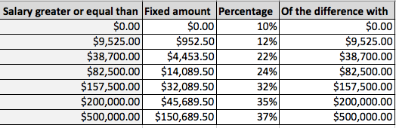
VLOOKUP – Approximate match
To calculate the income taxes we first need to create the following table:
We can either create it in the same sheet or in a separate one.
1st COLUMN MUST BE IN ASCENDING ORDER (when we are using approximate VLOOKUP)

Slide 32
VLOOKUP goes through the first column and stops when it finds a value that is higher than the salary it is looking up. Then it returns the tax rate corresponding to that row.
= VLOOKUP (H3, 'tax rates'!A$2:D$8, 3)
We want to look up the salary of each employee
This is the lookup range (located in the sheet named ‘tax rates’)
We want a value from the 3rd column of the range

Slide 33
Appendix I
Look up with nested MATCH and INDEX functions: a more general tool than VLOOKUP/HLOOKUP
Sales_Staff.xlsx

Slide 34
VLOOKUP – exact match
When was hired the person with telephone number (171)672-0656?
I can use VLOOKUP to answer this question:
=VLOOKUP (B27, D3:I23, 3, FALSE)
However if the question is:
What is the name of the person with telephone number (171)672-0656?
I cannot use VLOOKUP in this case, because the name’s column is on the left side of the telephone number column.

Slide 35
Look up with Match and Index
What is the name of the person with telephone number (171) 672-0656?
To answer this question we split it in two separate ones:
What is the position (row) of the phone number (171) 672-0656?
What is the Employee Name in that row?

Slide 36
MATCH
The MATCH function locates a value in an array and returns its relative position.
=MATCH (lookup_value, lookup_array, [match_type])
lookup_value is the value that you want to locate in the array or list (it can be a value or a reference to a cell that contains a value)
lookup_array is the cell range that contains the values (either a single row or column)
[match_type] is an optional argument that can take 1, 0 or -1 values.
1 (default) | The function finds the largest value that is less or equal to the lookup_value. The lookup_array must be sorted in ascending order.
-1 | The function finds the smallest value that is greater or equal to the lookup_value. The lookup_array must be sorted in descending order.
0 | The function finds the first value that exactly matches the lookup_value. The lookup_array can be in any order.

Slide 37
MATCH
What is the position (row) of the phone number (171) 672-0656?
When we locate certain information in a single column or row we use the MATCH function.
=MATCH (1716720656, D3:D23, 0)
This formula returns 11, since 1716720656 is in the 11th row of the range D3:D23.
Note: it does NOT return the spreadsheet row number of the cell containing 1716720656 (which is 13)!

Slide 38
INDEX
The INDEX function can work in two different ways:
It returns the content of a cell given its position on a array:
=INDEX (array, row_num, [column_num])
array is the array that contains the information you want.
row_num is the row number (with respect to the array, so row 1 is the first row of the array and not the first row of the worksheet) of the cell you want to get the value of.
column_num is the same as row_num but for the column
It returns a cell reference of a row and column intersection:
=INDEX (reference, row_num, [column_num], [area_list])
We are not going to use this version in this class though.

Slide 39
INDEX
What is the Employee Name in that row (11)?
Equivalently, what is the information that shows up on the 11th row and 1st column of our range?
When we want to know the information of a certain location, we use the INDEX function.
= INDEX(A3:I23, 11, 1)
Relative position of the cell with respect to the range A3:M23!

Slide 40
MATCH and INDEX nested
The true power behind the MATCH and INDEX functions lies when they are used nested: first we locate the position of a certain information with MATCH and then we return related information with INDEX.
What is the salary of the person whose phone number is (671)-601-8444?
The formula that gives the answer is:
= INDEX (A3:I23, MATCH (1716720656, D3:D23, 0), 1)
Note that the ranges have to be consistent! If in MATCH we started from the 3rd row of the Excel sheet (D3:D23), in INDEX we also have to start from the 3rd row (A3:M23)!

Slide 41
INDEX and MATCH another question
What is the job rating of the person with highest salary?
First, we calculate the highest salary with MAX:
= MAX (H3:H23)
Then we locate it in the table with MATCH:
= MATCH (MAX (H2:H23), H3:H23, 0)
Then we return the employee’s job rating with INDEX:
= INDEX (A2:I22, MATCH (MAX (H3:H23), H3:H23, 0), 9)
Note: since the job rating is to the left of the salaries column, we can use VLOOKUP instead of MATCH and INDEX:
=VLOOKUP (MAX (H3:H23), H3:I23, 2, FALSE)
If, instead of the job rating, we wanted the name or the building or the hire date, could we have used VLOOKUP?

Slide 42
Appendix II
Data validation
Staff.xlsx and Staff_solutions.xlsx

Slide 43
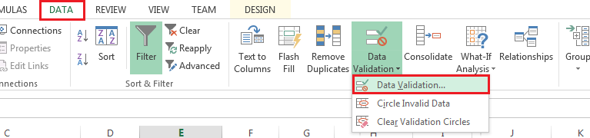
Data Validation
Data validation allows you to control the data that can be entered into a cell.
For instance, the company only has 6 buildings, so when one is entering new data about an employee, only one of these 6 buildings should be allowed on the Building column. The same applies to other fields.

Slide 44
Data Validation
Create data validation rules to the following:
Only allow the insertion of buildings and departments the company has;
Only allow the following possible status: Hourly, Full-time, Half-time and Contract;
Only allow a number between 1 and 5 for the job rating;

Slide 45
Appendix III
List of error codes and some helpful functions for dates and text

Slide 46
Errors help
Error | Meaning
#DIV/0! | Trying to divide by 0
#N/A! | A formula or a function inside a formula cannot find the referenced data
#NAME? | Text in the formula is not recognized
#NULL! | A space was used in formulas that reference multiple ranges; a comma separates range references
#NUM! | A formula has invalid numeric data for the type of operation
#REF! | A reference is invalid
#VALUE! | The wrong type of operand or function argument is used

Slide 47
Some text functions
LEFT | Extracts one or more characters from the left side of a text string
RIGHT | Extracts one or more characters from the right side of a text string
MID | Extracts characters from the middle of a text string; you specify which character position to start from and how many characters to include
CONCATENATE | Assembles two or more text strings into one
REPLACE | Replaces part of a text string with other text
LOWER | Converts a text string to all lowercase
UPPER | Converts a text string to all uppercase
PROPER | Converts a text string to proper case (e.g. changes “john doe” to “John Doe”)
LEN | Returns a text string’s length (number of characters)

Slide 48
Some date functions
NOW | Returns the current date & time
TODAY | Returns today's date
DAY | Returns the day (of the month) from a user-supplied date
MONTH | Returns the month from a user-supplied date
YEAR | Returns the year from a user-supplied date
NETWORKDAYS | Returns the number of whole work days (excluding weekends & holidays), between two supplied dates
YEARFRAC | Calculates the fraction of the year represented by the number of whole days between two dates

Slide 49
=VLOOKUP([@Salary],'Tax rates'!A$2:C$8, 2) + VLOOKUP([@Salary],'Tax rates'!A$2:C$8, 3) * ([@Salary] - VLOOKUP([@Salary],'Tax rates'!A$2:C$8,1))

